Slide 1



SMART AGRICULTURE SUPPLY CHAIN TRACKER
PL/SQL Oracle Database Solution KENYA FOCUS
Fatime Dadi Wardougou 25858
Database Development with PL/SQL (INSY 8311)
Adventist University of Central Africa
November 17, 2025
Notes:
1

Slide 2
THE REAL PROBLEM: KENYA'S AGRICULTURAL CHALLENGES
CONCRETE KENYA EXAMPLE:
KENYA-SPECIFIC DATA:
Maize farmer in Trans Nzoia produces 125,391 tons annually
6.3 million households engaged in farming (KNBS 2023)
Transportation delays to Nairobi markets cause 20% spoilage
Post-harvest losses: 20-40% for perishable crops
Price fluctuations between counties cost farmers 30% potential income
Supply chain inefficiencies cost billions annually
Inefficient routes waste 25% in fuel costs
Reference: Kenya National Bureau of Statistics - Agricultural Survey
Notes:
2

Slide 3

CASE STUDY: MAIZE TRANSPORT FROM TRANS NZOIA TO NAIROBI
WITH OUR SYSTEM:
PROBLEM SCENARIO:
Trans Nzoia produces 125,391 tons of maize annually
Real-time route optimization via Eldoret-Nakuru alternative
Truck breakdowns on Eldoret-Nairobi highway cause 2-day delays
Moisture sensors trigger immediate protective measures
Moisture exposure reduces quality and market price by 40%
Market price alerts suggest optimal selling times
Farmers receive only 60% of potential revenue
Estimated outcome: 85% value preservation
Harvesting
Loading
Transportation
Market Delivery
Notes:
3

Slide 4

WHO BENEFITS IN KENYA?
PRIMARY USERS:
IMPACT MEASUREMENT:
Smallholder Farmers (from data: 6.3 million households)
Reduced spoilage: 30% → 12% target
Transport Companies (serving 47 counties)
Increased farmer income: 20-35% improvement
Agricultural Cooperatives (e.g., maize, coffee, tea cooperatives)
Transportation efficiency: 25% fuel savings
County Government Officials (agriculture departments)
Better price realization across counties
Notes:
4

Slide 5
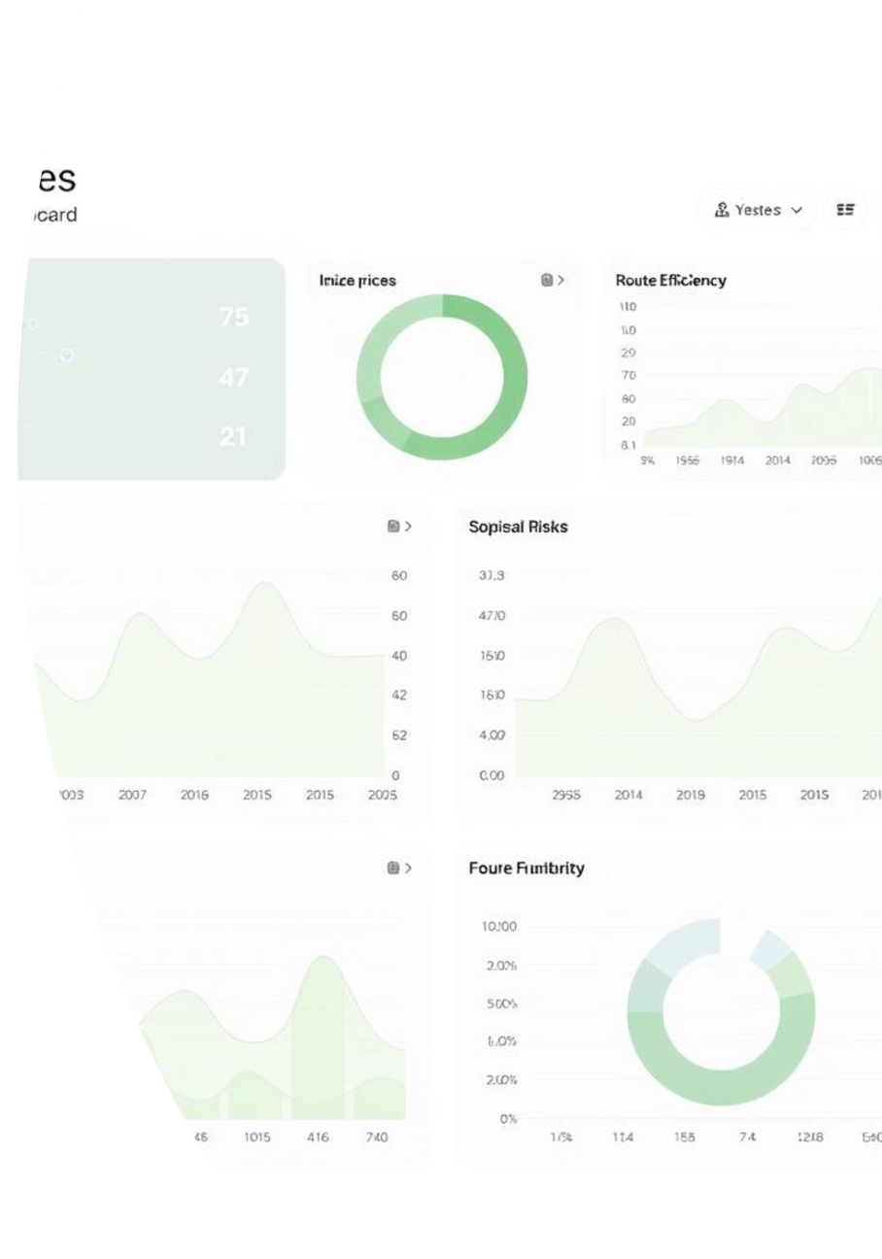
BUSINESS INTELLIGENCE - KENYA FOCUS
PREDICTIVE ANALYTICS:
DASHBOARD KPIs:
DATA-DRIVEN DECISIONS:
County-level production vs market demand gaps
"Maize prices in Nairobi will peak next week - recommend holding shipment"
Farmers: Optimal selling time based on county price patterns
Real-time price differentials between counties
Transporters: Most efficient inter-county routes
"Alternative route via Thika saves 3 hours during rainy season"
Transportation efficiency scores per route
County Governments: Strategic storage facility placement
Spoilage risk alerts by crop type
"Tomato oversupply predicted in Kiambu - divert to undersupplied markets"
Notes:
5

